Slide 1

Project Title: LUDO GAME
Submitted By:
Name Roll No. Registration No.
Praveen Kumar Tiwari RK21ZNB44 12104582
Rahul Singh Chouhan RK21ZNB56 12112405
Prakash Sah RK21ZNB62 12112811
Submitted To:
Professor Chandani Bhasin
Course Code:CSE310

Slide 2

Introduction to Ludo Game in Java
Ludo is a popular board game that has been played for generations. It is a game of strategy, luck, and skill that can be enjoyed by people of all ages.
In recent years, the game has been adapted into a digital format, allowing players to enjoy the game on their computers or mobile devices. One such adaptation is the Ludo game in Java.

Slide 3
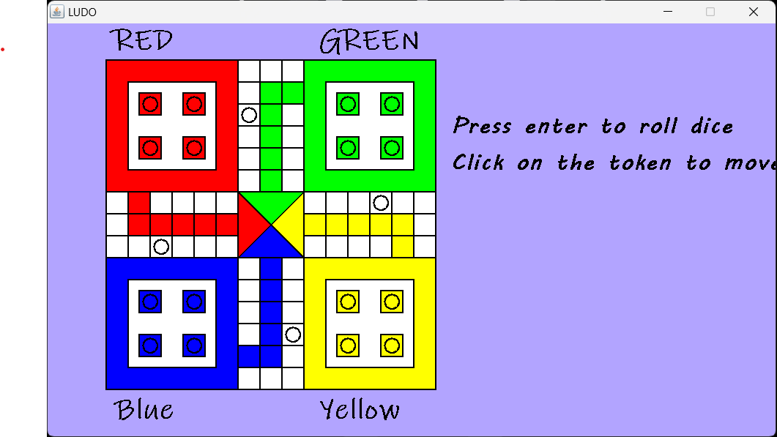

Slide 4
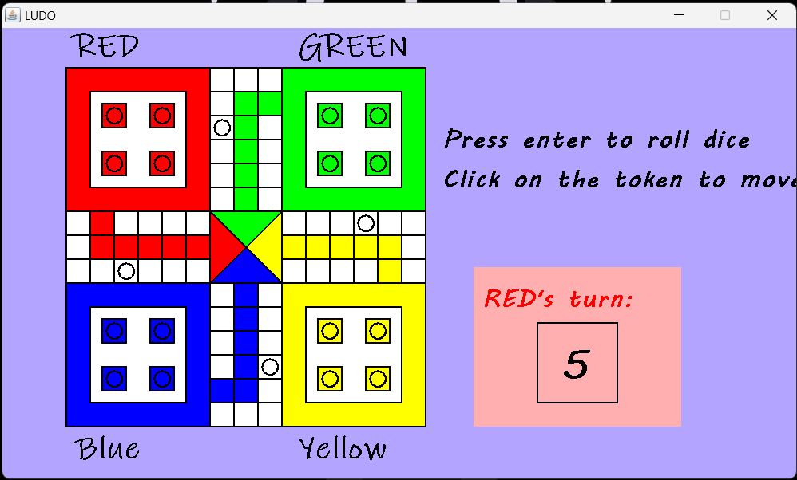

Slide 5

Conclusion: Ludo Game in Java
Overall, Ludo game in Java is a fun and engaging way to enjoy the classic board game. It offers a faithful recreation of the original game, with added convenience and accessibility.
Whether you're playing against friends or challenging yourself against the computer, Ludo game in Java is sure to provide hours of entertainment and mental stimulation.

